Slide 1
DATA STRUCTURES
ARRAYS

Slide 2
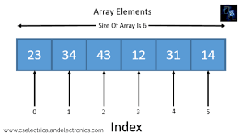
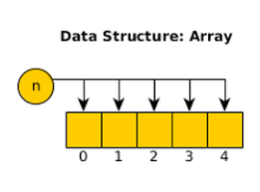
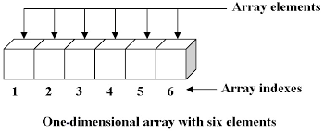
What is an Array?
An array is a linear data structure that collects elements of the same data type and stores them in contiguous and adjacent memory locations. Arrays work on an index system starting from 0 to (n-1), where n is the size of the array.

Slide 3
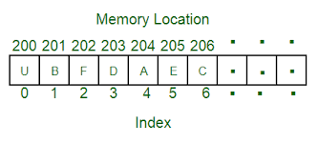
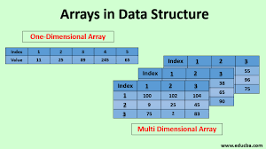
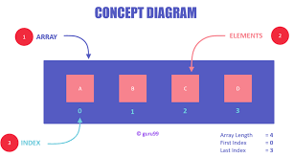
Arrays

Slide 4
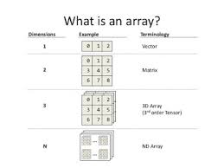
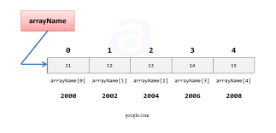
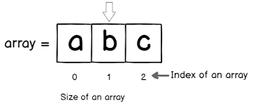
Properties Of Arrays
There are some of the properties of an array that are listed as follows -
Each element in an array is of the same data type and carries the same size that is 4 bytes.
Elements in the array are stored at contiguous memory locations from which the first element is stored at the smallest memory location.
Elements of the array can be randomly accessed since we can calculate the address of each element of the array with the given base address and the size of the data element.

Slide 5
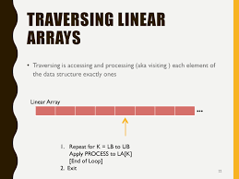
Operations On Arrays
Traversal - This operation is used to print the elements of the array.
Insertion - It is used to add an element at a particular index.
Deletion - It is used to delete an element from a particular index.
Search - It is used to search an element using the given index or by the value.
Update - It updates an element at a particular index.

Slide 6


